Slide 1
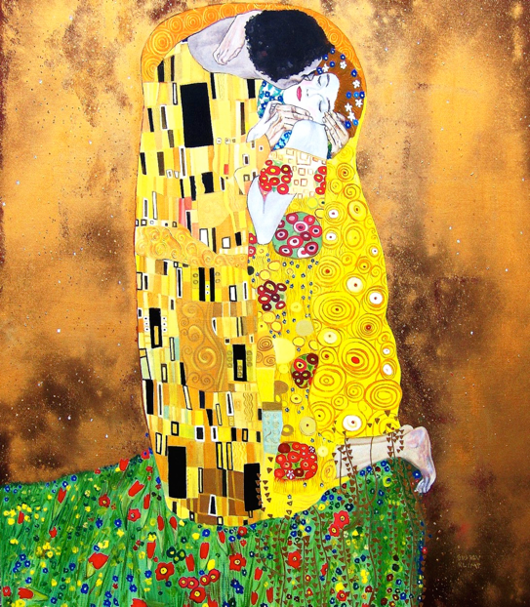
Week 6 – Spiritual Belief, Cycle of Life, & Love and Sex
ARTS 1301 Art Appreciation

Slide 2
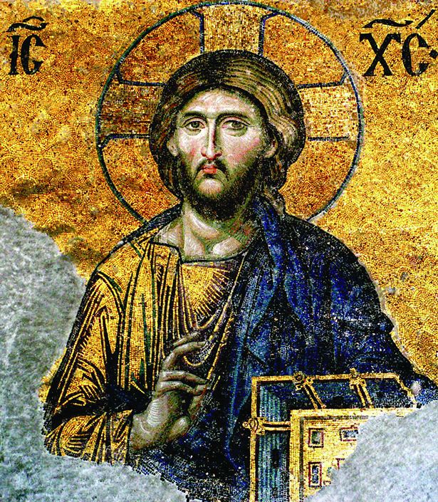
Art of Spiritual Belief
ARTS 1301 Art Appreciation

Slide 3
Connecting with Spirits and the Divine

Slide 4
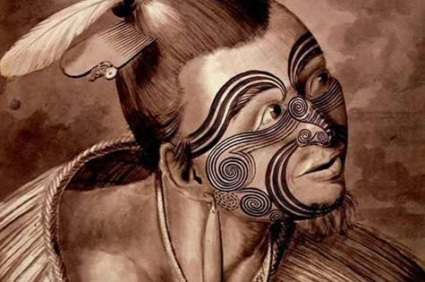
Portrait of a Maori, Sydney Parkinson 1769 The head, particularly the face was tattooed by the Maori because it was considered the most sacred. This gave the tattooded person power.
Video

Slide 5
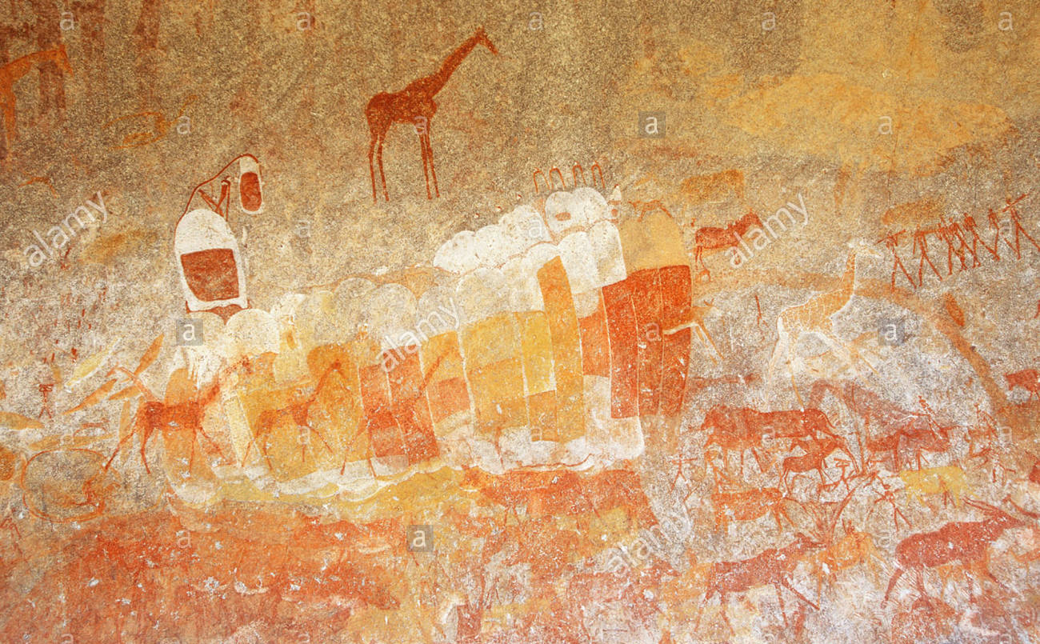
Art in Inanke cave, Matopos, Zimbabwe, Africa cir. 950 AD
Video

Slide 6
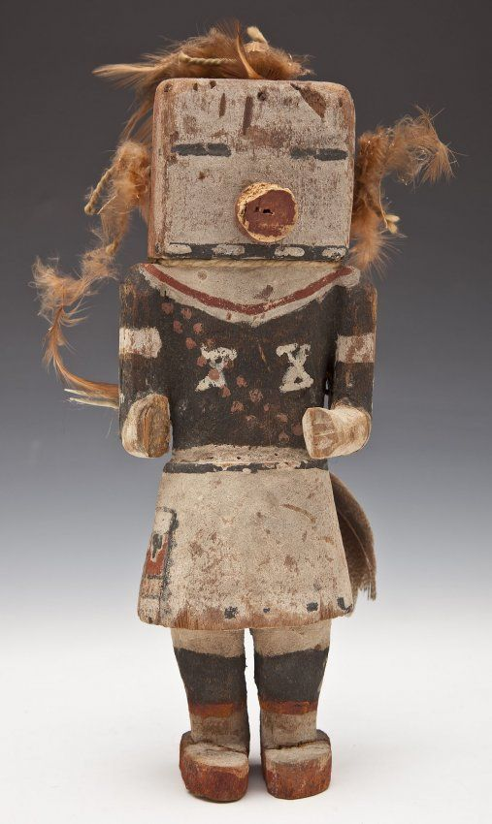
Hopi Kachina, Arizona, USA cir. 1880. The Pueblo people used Kachinas in their spiritual rituals.
Video

Slide 7
Christ from Deesis Mosaic, Hagia Sofia, Istanbul 13th century

Slide 8
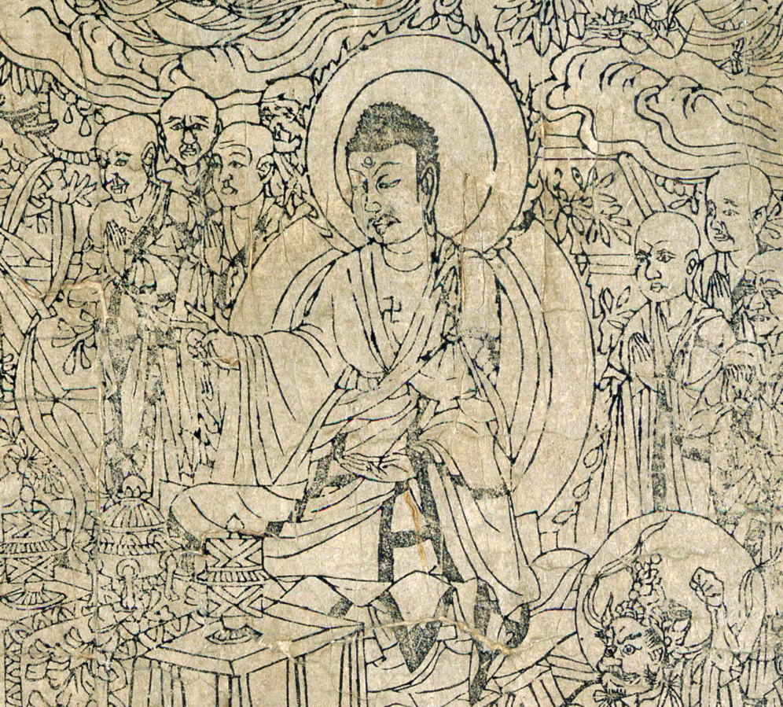
Frontispiece diamond sutra from cave 17 Dunhuang,
Tang Dynasty 868 AD
Video

Slide 9
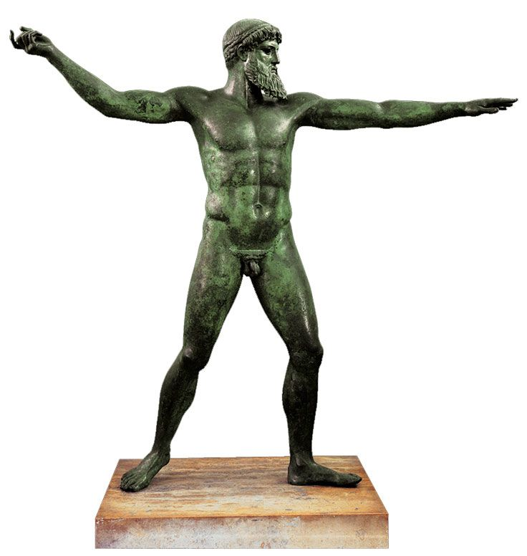
Poseidon, bronze statue, Greece 460 BC found in a shipwreck. Depicts the perfect anatomy of ancient Greek gods as well as ancient Greek athletes.

Slide 10
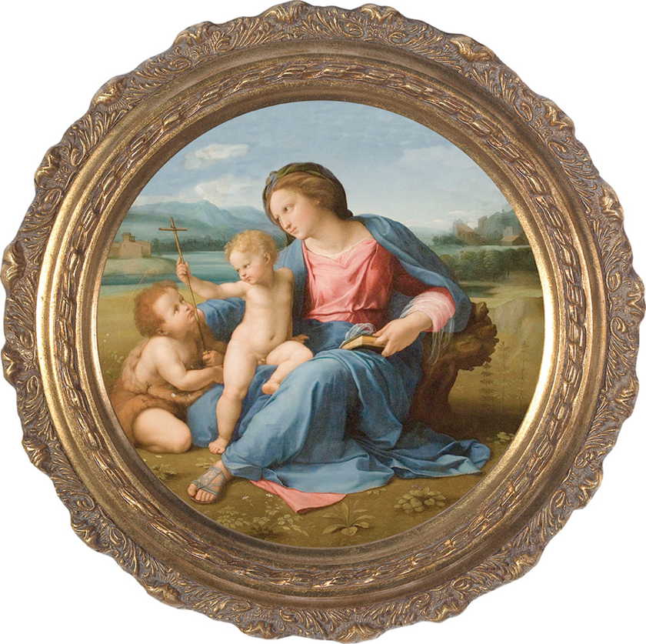
The Alba Madonna, Raphael, Italy 1510 AD. National Gallery in Washington DC. Depicts Mary, Jesus, and John the Baptist.
Video

Slide 11
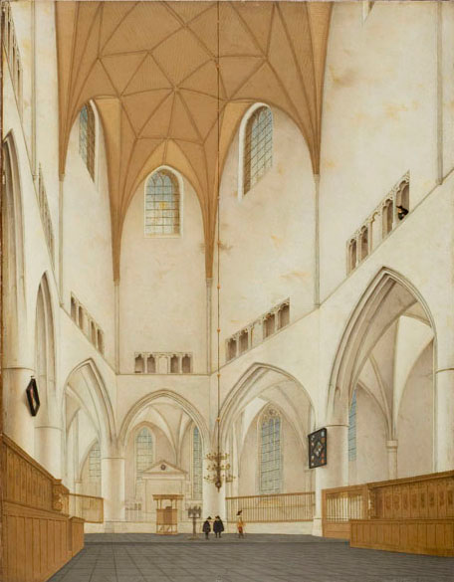
Interior of the Choir of Saint Bavo's Church, Pieter Saenredam, oil on panel, 1660 AD. The Protestant Reformation forbade the decoration found in Roman Catholic and Greek Orthodox churces.

Slide 12
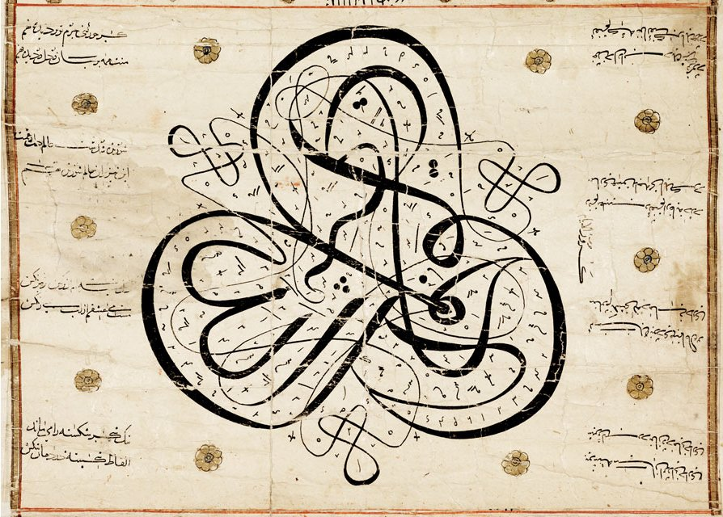
Calligraphic scroll, Syria, cir. 15th century. Images representing God are forbidden in Islam.

Slide 13
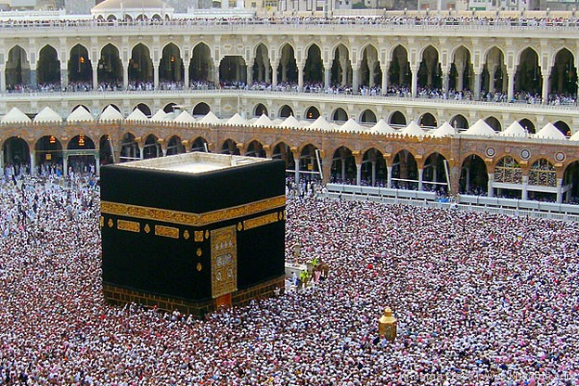
The Kaaba, Haram Mosque, Mecca, Saudi Arabia

Slide 14
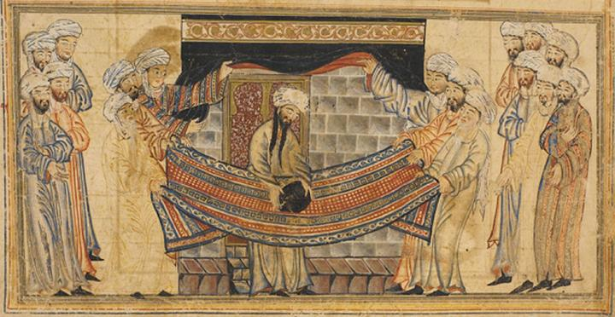
Muhammad placing the black stone of kaaba on his cloak
Illuminated manuscript 1315 AD. Images of people are rare in Islamic art, and Images representing God are forbidden in Islam.

Slide 15
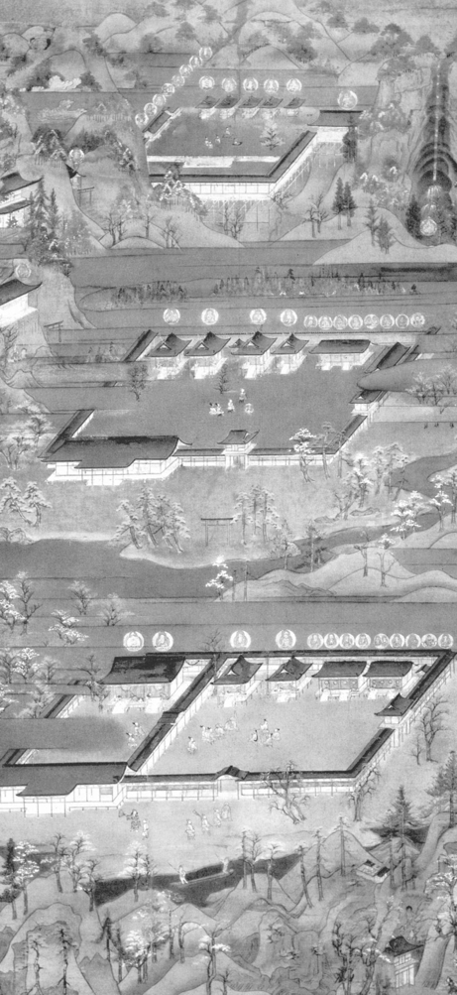
Kumno Mandala, showing three sacred shrines of the
Kumano Kodo Pilgrimage Trail where the three shrines of Kumano lare ;ocated south of Osaka, Japan
Kamakuro period.
ink with color on
hanging silk scroll,
Japan cir. 1300.
The pilgrimage is still taken today. The journey is in itself a form of spiritual sacrifice, satisfaction and meditation
Video

Slide 16
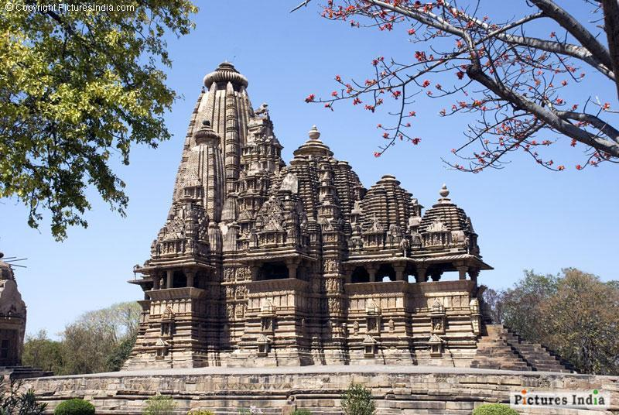
Kandariya Mahadeva temple at the sacred site of Khajuraho,
Madhya Predesh, India , cir. 1025

Slide 17
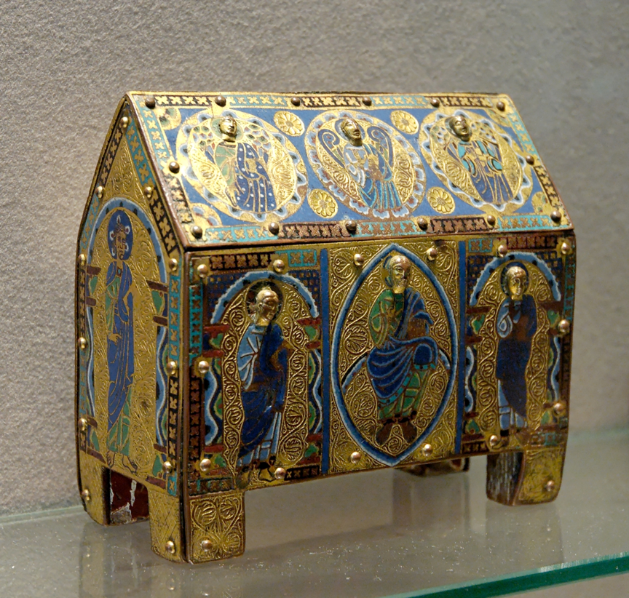
A reliquary is a container that holds the relics of a saint or holy person that includes bones, bits of clothing or other artifacts.

Slide 18
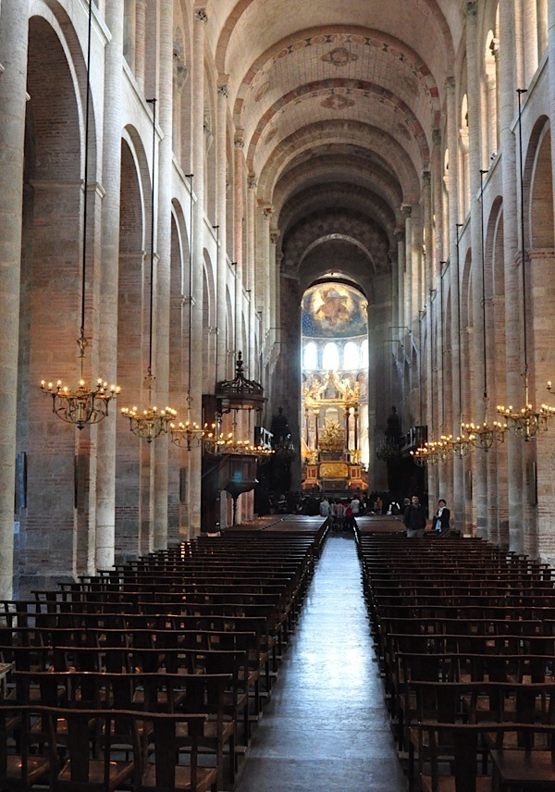
View of the nave, St. Serin Cathedral, Toulouse, France built 1080-1120 AD
One of the points along the pilgrim’s ways in France and Spain.
Modern-day pilgrims still walk long distances over weeks or months to spiritual or religious shrines rather than taking modern transportation.
The journey is in itself a form of spiritual sacrifice, satisfaction and meditation

Slide 19
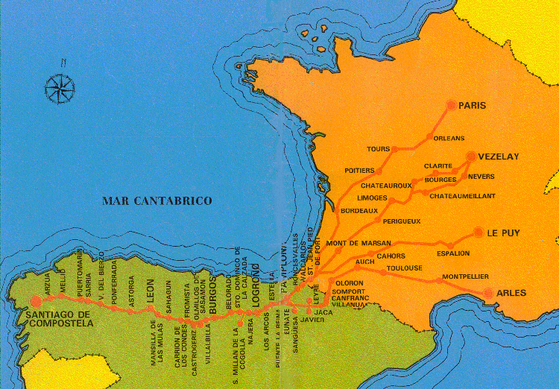
Pilgrimage map to Santiago de Compostela (relics of St. James)
Video

Slide 20
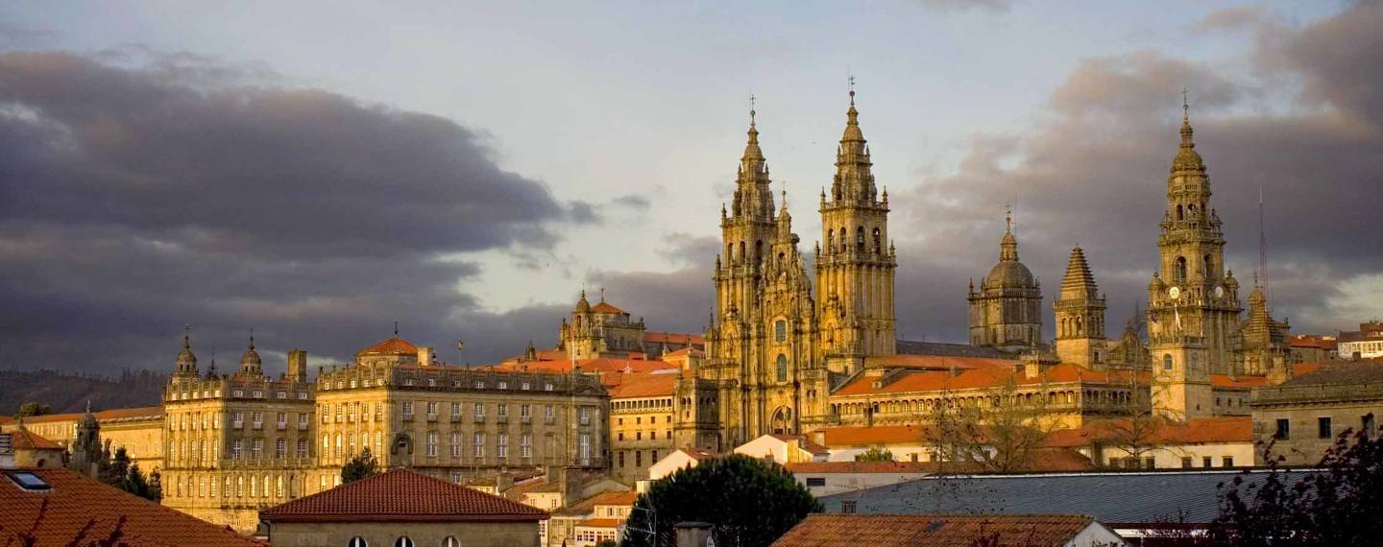
Pilgrim destination: Cathedral Santiago de Compostela, Spain
Video

Slide 21
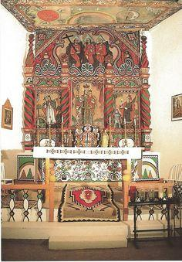
Retablo and high alter, Church of San Jose, Laguna Pueblo, New Mexico 1780-1810

Slide 22
Spirituality and Abstraction

Slide 23
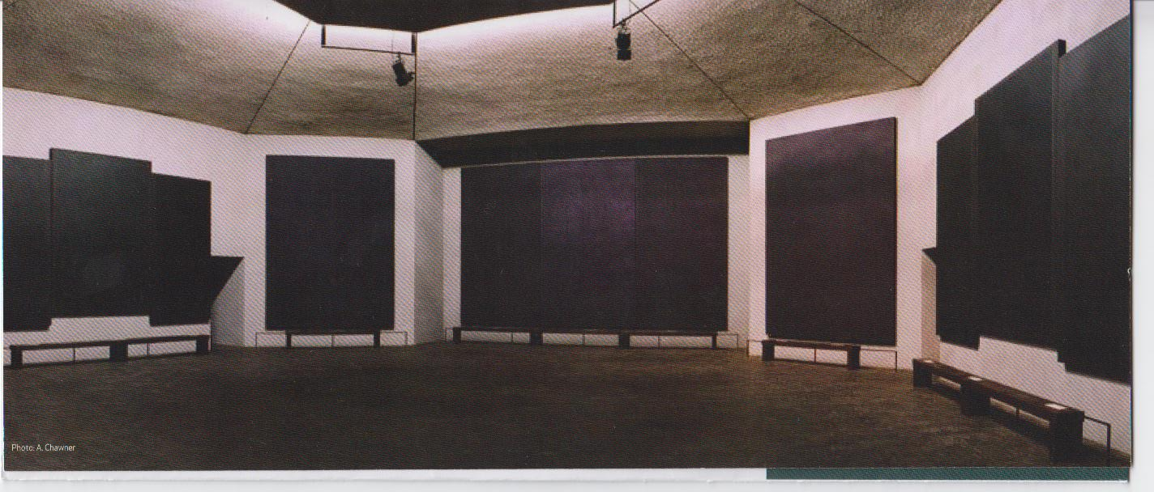
Rothko Chapel, Mark Rothko, Houston, Texas 1971
Video

Slide 24
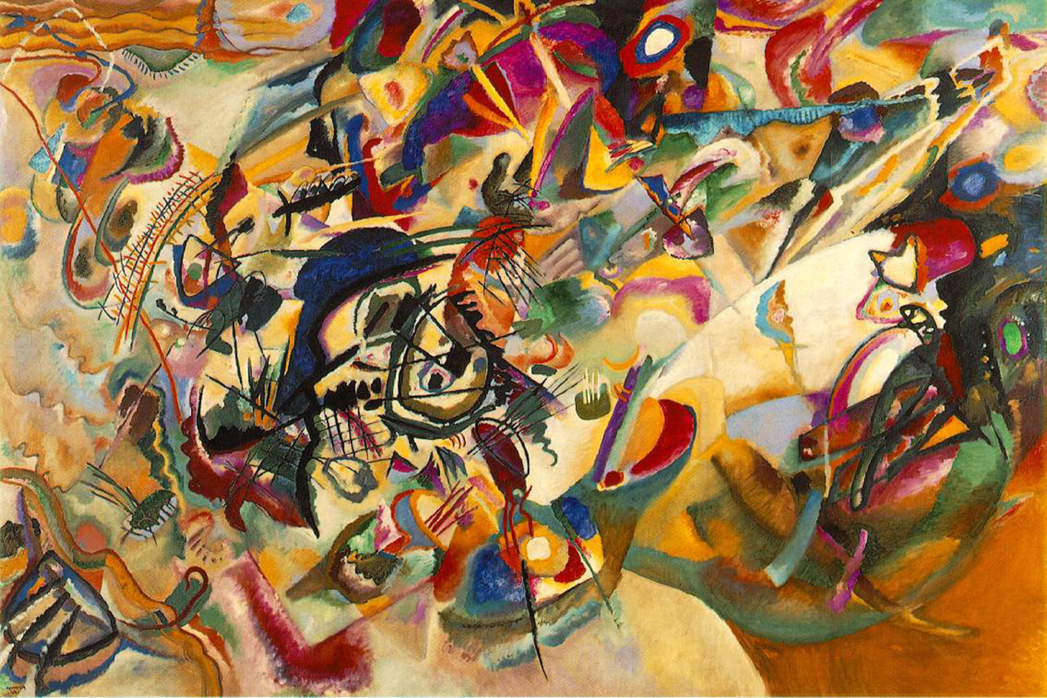
Composition VII, Wasslly Kandinnsky, oil on canvas 1913
Video

Slide 25
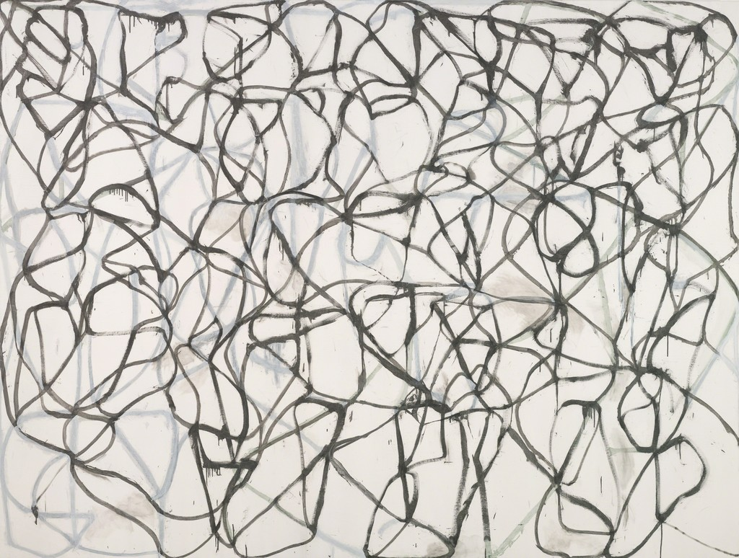
Cold Mountain and Bridge, Bryce Marden, oil on linen 1989-1991
Video

Slide 26
REVIEW
The Pueblo people of the American Southwest use Kachina statues in their spiritual rituals.
The head, particularly the face was tattooed by the Maori people of New Zealand because it was considered the most sacred part of the body.
Images representing God are prohibited in all Islamic art.

Slide 27
REVIEW
The ancient Greek gods had perfect physical bodies in common with the ancient Greek Olympic atheletes.
.

Slide 28
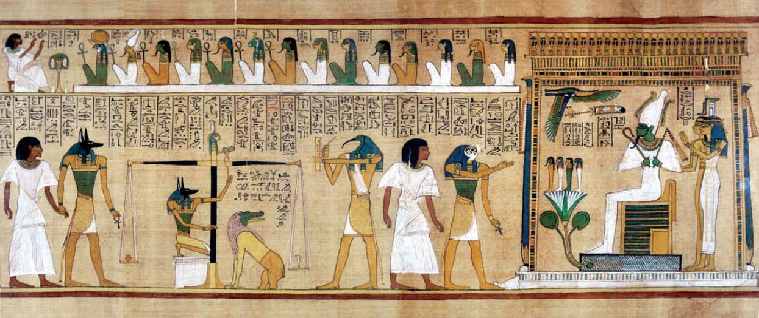
The Cycle of Life
ARTS 1301 Art Appreciation

Slide 29
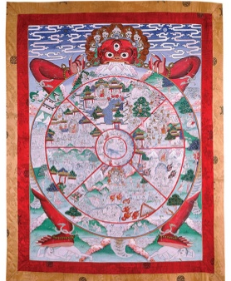
Thanka Depicting the Wheel of Llife, Bhutan 15th century
Video

Slide 30
Birth

Slide 31
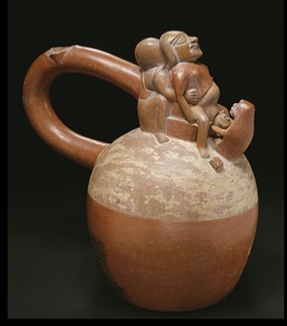
Vessel with Birth Scene, Moche culture, Peru 700 AD. Produced clay objects in molds. The figures often were sexual in nature referring fertility.

Slide 32
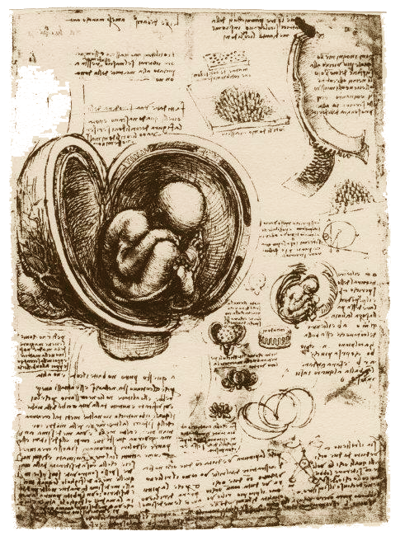
Embryo in the Womb, Leonardo da Vinci, pen and brown ink on paper, Italy 1513 AD. Not only was Leonardo an artist, but also he was one of the first to study the internal anatomy of a deceased human (finding an unborn infant embryo), contributing to an emerging science, even when the powerful church forbade disections.

Slide 33
Pregnant Eve, panel from the Ghent Alterpiece, Jan Van Eyck, oil on panel 1432. New research does not believe that the image shows her pregnant afterall, but depicts her painted by , Jan Van Eyck, with enough fat to be the preferred female fertile image type.

Slide 34
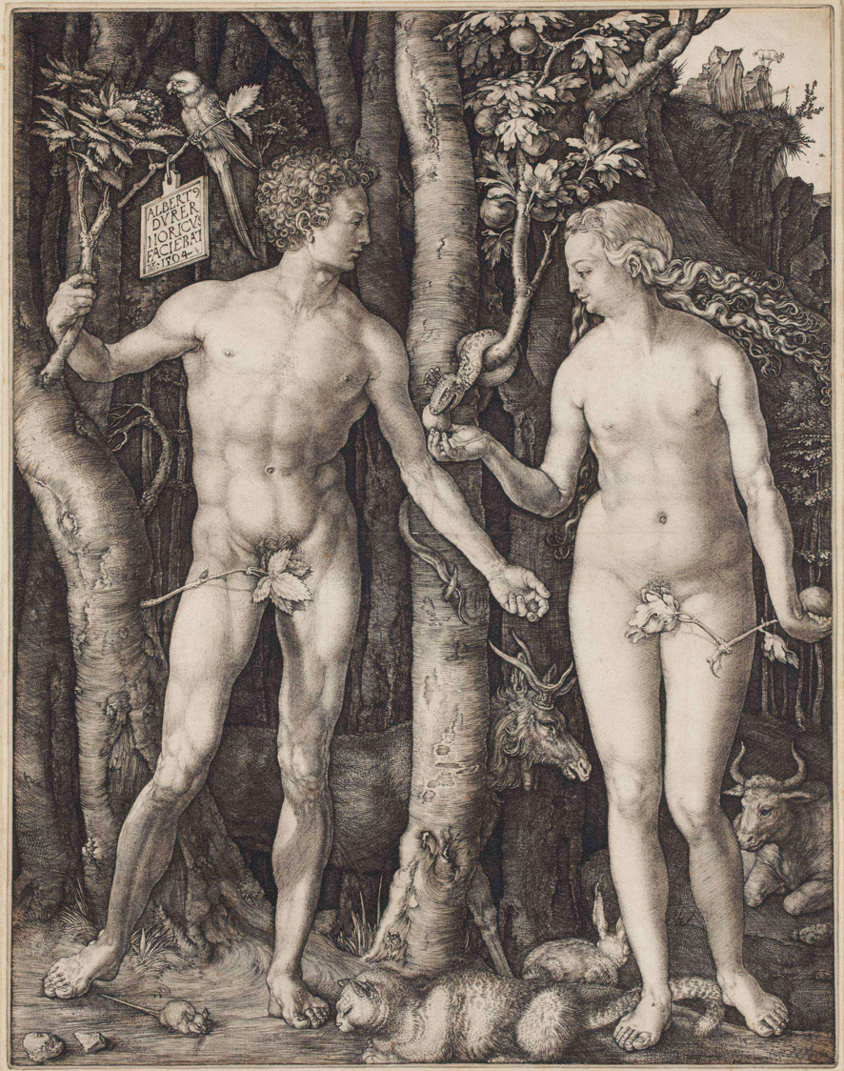
Adam and Eve, etching, Albrecht Dürer, 1504

Slide 35
Youth and Aging

Slide 36
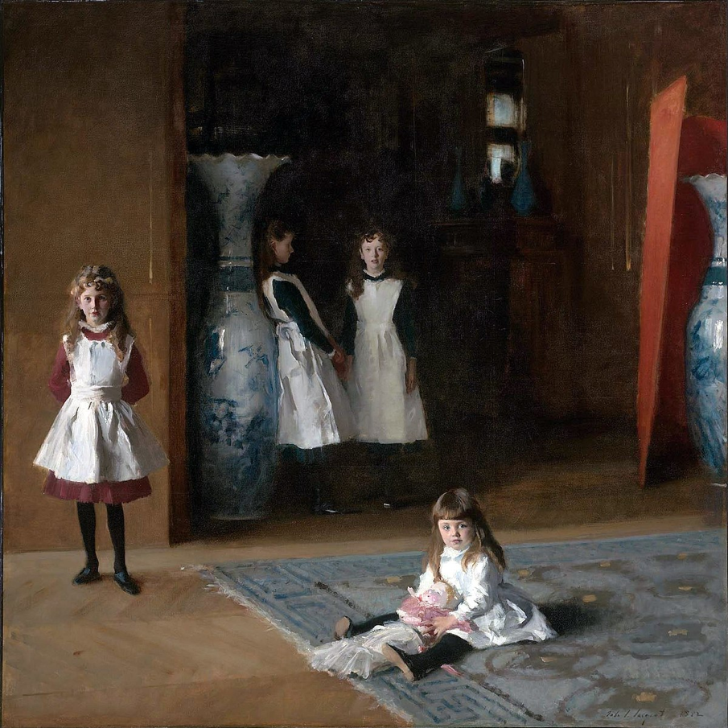
The Daughters of Edward Darley Boil, John Singer Sargent,
oil on canvas 1882

Slide 37
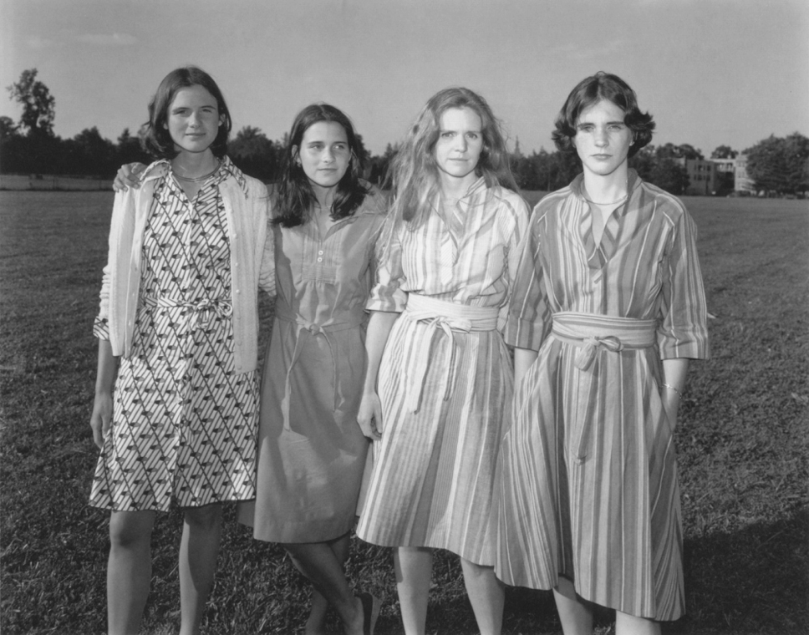
The Brown Sisters, Nicholas Nixon, photo 1976. Aging over time was achieved in Nicholas Nixon’s photos in The Brown Sisters series?
Video

Slide 38
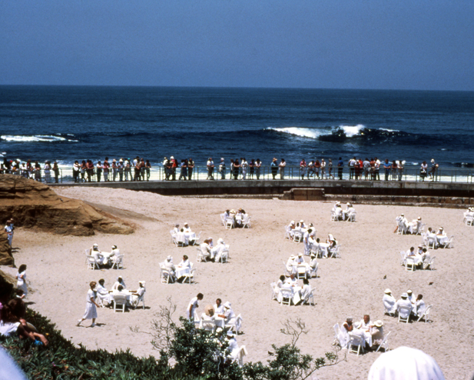
Whisper the Waves the Wind, Suzanne Lacy, photo 1985. Aging issues are commonly addressed in Suzanne Lacy’s performances. Lacy worked with a group of Southern California women over the age of 65 to produce a series of policy and media actions that culminated in an oceanfront performance for an audience of 1000.
.
Video

Slide 39
Contemplating Mortality

Slide 40
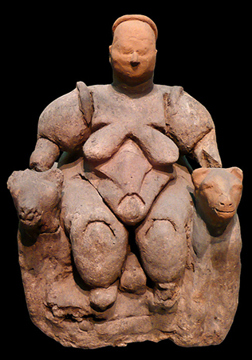
Woman Seated Between Two Felines, Turkey cir. 6850 BC. The Seated Woman of Çatalhöyük (also Çatal Höyük) is a baked-clay, nude female form, seated between feline-headed arm-rests.. The statuette, one of several iconographically similar ones found at the site, is associated to other corpulent prehistoric goddess figures, of which the most famous is the Venus of Willendorf.

Slide 42
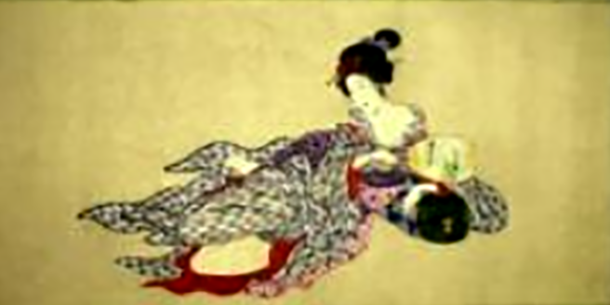
The impermanence of the physical body
Body of a Courtesan in Nine Stages of Decomposition, Japan 1870

Slide 43
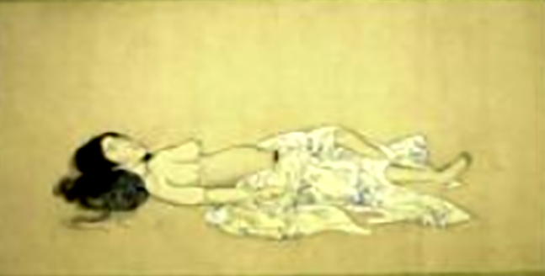
Body of a Courtesan in Nine Stages of Decomposition, Japan 1870

Slide 44
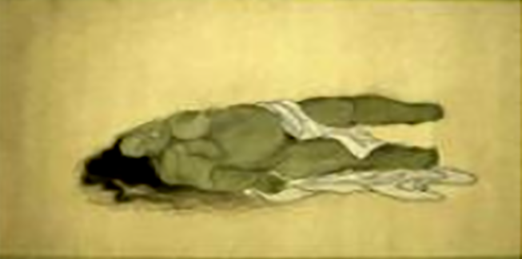
Body of a Courtesan in Nine Stages of Decomposition, Japan 1870

Slide 45
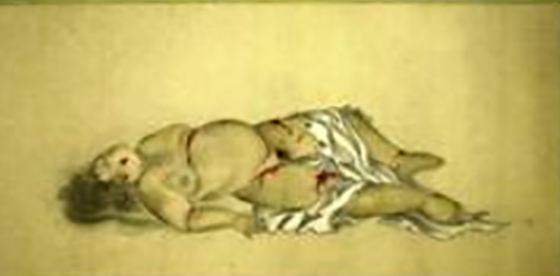
Body of a Courtesan in Nine Stages of Decomposition, Japan 1870

Slide 46
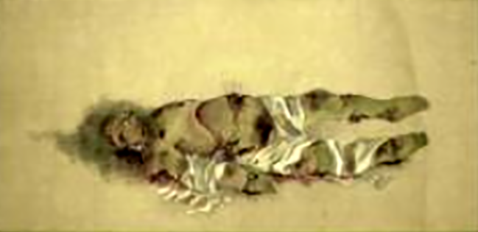
Body of a Courtesan in Nine Stages of Decomposition, Japan 1870

Slide 47
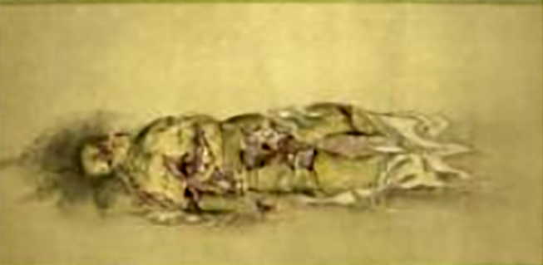
Body of a Courtesan in Nine Stages of Decomposition, Japan 1870

Slide 48
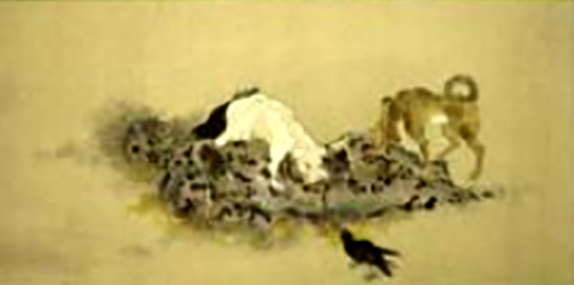
Body of a Courtesan in Nine Stages of Decomposition, Japan 1870

Slide 49
Burial and the Afterlife

Slide 50
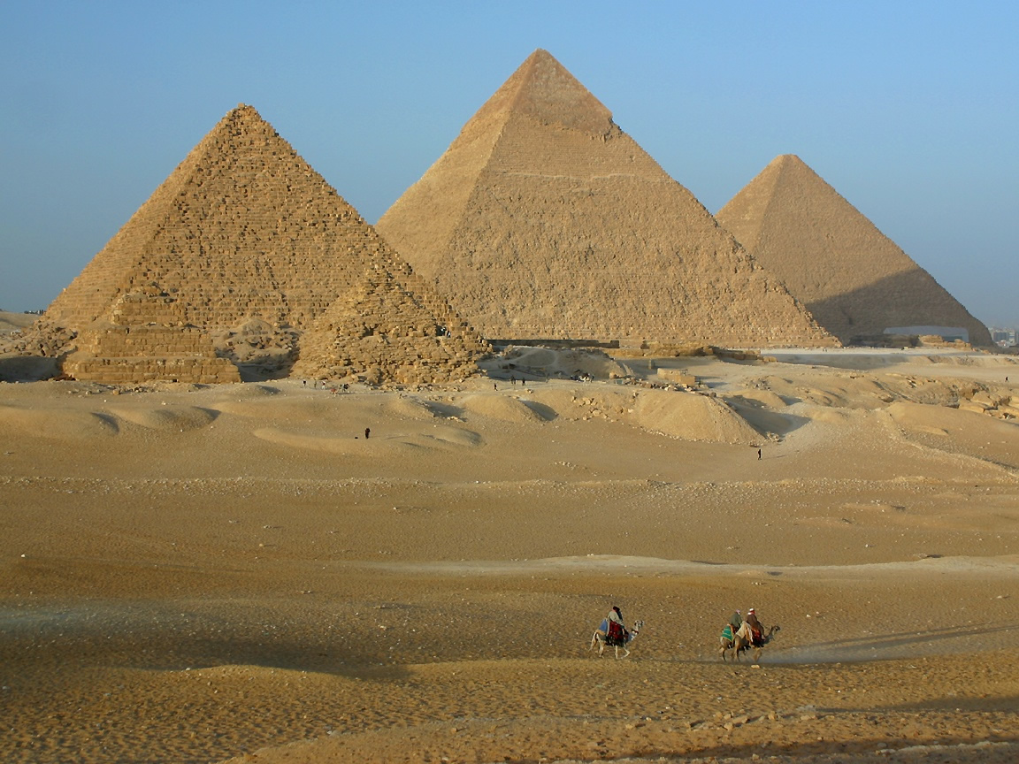
Great Pyramids of Giza, Egypt 2530 BC. They were built like a religious machine to ensure the king's passage to the afterlife.

Slide 51
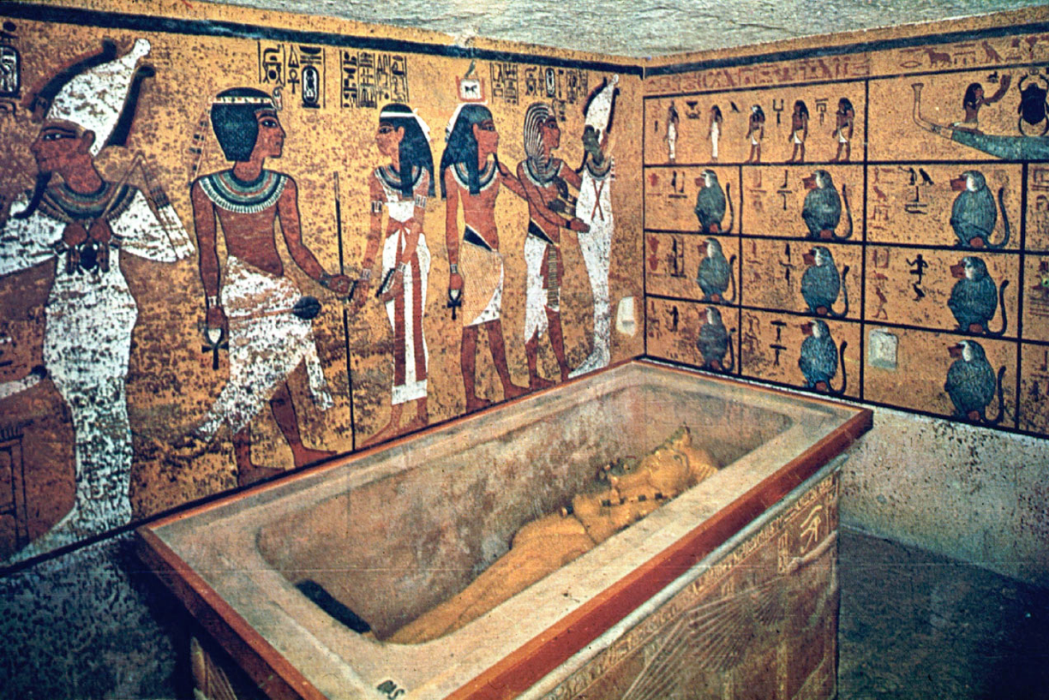
King Tutankhamen tomb, Valley of the Kings, Egypt 2530 BC

Slide 52
Egyptian Book of the Dead: Last Judgement of Hunefer by Osiris, Egypt 1285 BC. instructions for successfully passing the obstacles of the afterlife
Video

Slide 53
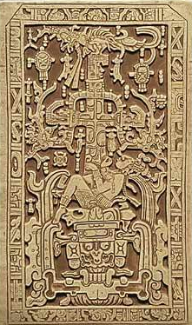
Sarcophagus cover, Temple of Inscriptions, Palenque,
Mexico 683 AD

Slide 54
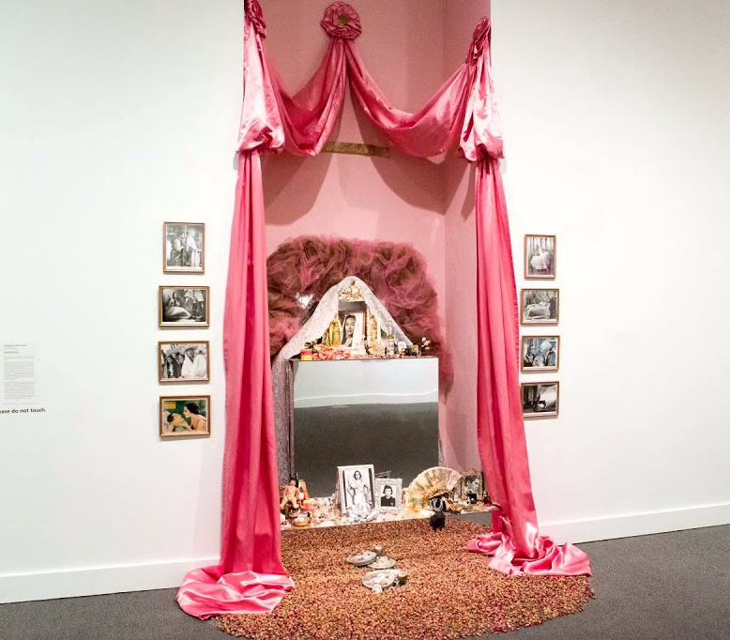
An Ofrenda for Dolores del Rio, Amalia Mesa-Bains, 1984
Video

Slide 55
REVIEW
The Moche culture in Peru produced clay objects in molds. The figures often were sexual in nature referring fertility.
New research about the Pregnant Eve, a panel from the Ghent Alterpiece, painted by Jan Van Eyck does not believe that the image shows her pregnant, but instead depicts her with enough fat to be the preferred female fertile image type.

Slide 56
REVIEW
The Wheel of Life, Buddhism, Bhutan 15th century, represents that we must transform ourselves if we are to achieve enlightenment, the highest state of existance.
The ancient Great Pyramids of Egypt were made to ensure the king's passage to the afterlife.

Slide 57
REVIEW
Women and aging issues are commonly addressed in Suzanne Lacy’s performances.
Aging over time was achieved in Nicholas Nixon’s photos in The Brown Sisters series.
the impermanence of the physical body is the similar theme found in both The Brown Sisters, Truro, Massachusetts, and Body of a Courtesan in Nine Stages of Decomposition.

Slide 58
REVIEW
The purpose of the The Last Judgement of Hunefer by Osiris... from a papyrus book cir. 1285 BC were instructions for successfully passing the obstacles of the afterlife.

Slide 59
Love and Sex
ARTS 1301 Art Appreciation

Slide 60
Love and Sex
Almost all cultures have struggled to resolve the tension between mere physical desire and the higher orders of feeling associated with more spiritual ideas of love. In his Republic, for instance, the Greek philosopher Plato argued that sex should be permitted only for purposes of procreation. Anything that encouraged emotional and sensory feelings over and against the exercise of reason and the pursuit of ideal beauty, he believed, was potentially a danger to the well-being of the state. Various forms of this attitude have survived in Western culture to the present day. But in other cultures sex and physical passion are something to be celebrated.

Slide 61
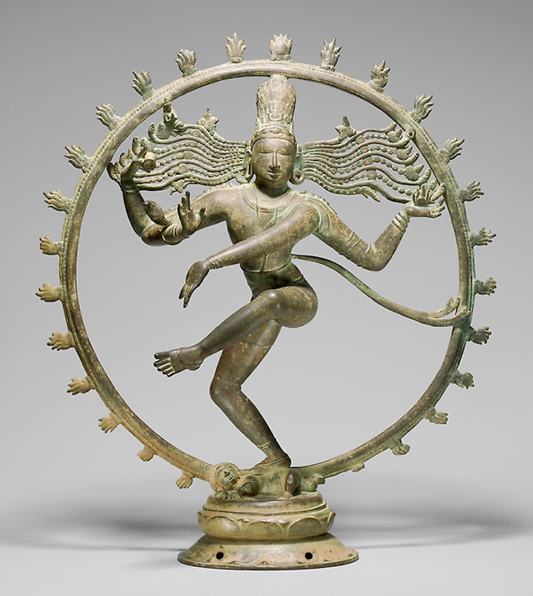
Love and Sex in the Hindu World

Slide 62
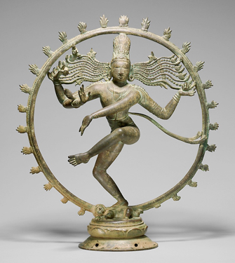
Shiva, Lord of the Dance, bronze, India 1279. One of the most important figures in the Hindu pantheon of gods is Shiva, the destroyer. He embodies the world’s cyclical rhythms—hence his role as Lord of the Dance—and since the cyclical destruction of the world is followed by its new creation, he is a positive force, possessing the reproductive powers that led him to be represented as a lingam (phallus), often carved in stone on temple grounds or at shrines.

Slide 63
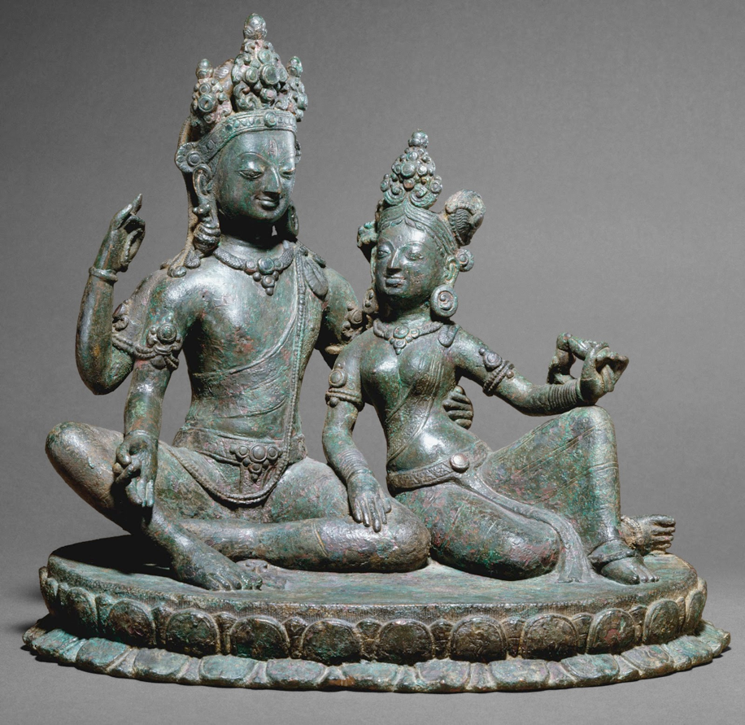
Shiva Seated with Uma, Kathmandu, Copper alloy, 11.5 “ tall, Nepal 11th Century

Slide 64
One of the most popular representations of Shiva among Nepalese Hindus shows him seated with his wife, Uma (Fig. Uma tenderly places her hand on the inside of his thigh as he draws her to him with his left hand. In her left hand, Uma holds a lotus, symbol of divine purity, but a parrot, symbol of physical passion, is pecking at it. Thus, physical and spiritual love are conjoined, just as the joyful harmony between male and female, Shiva and Uma, represents the ultimate oneness and harmony of the universe.

Slide 65
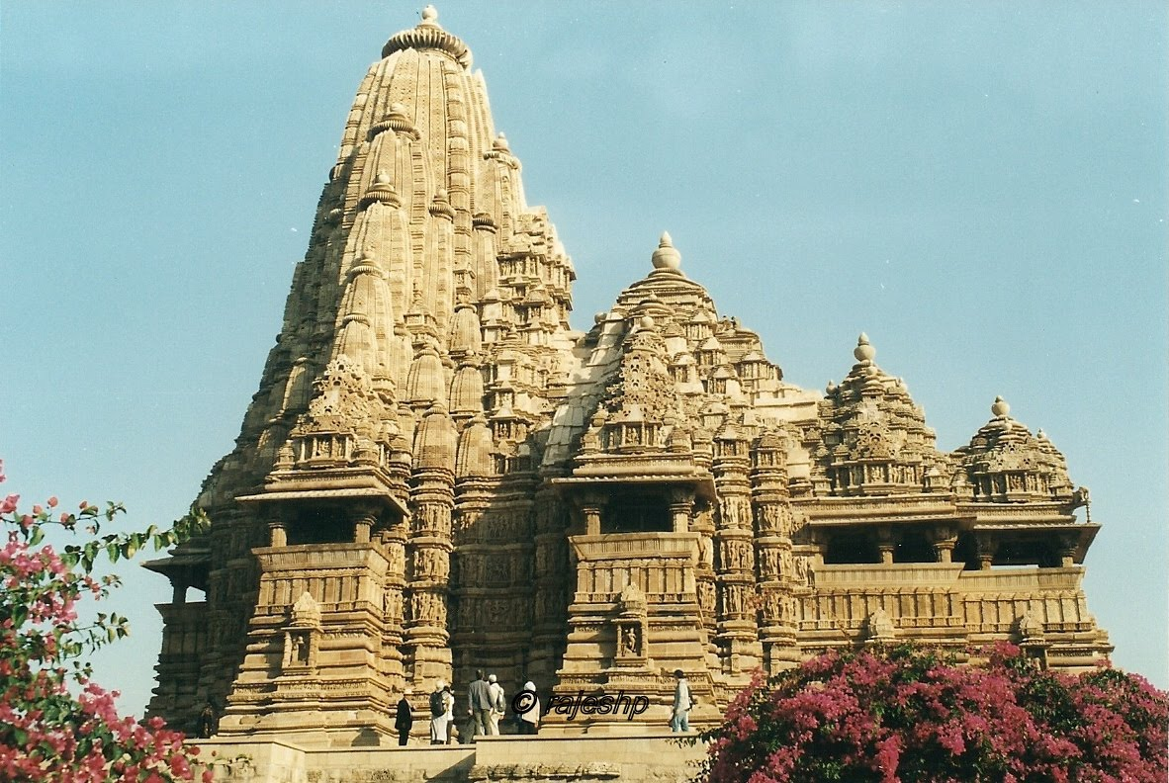
Erotic couples on wall of Kandariya Mahadeva Temple, Khajuraho, India 1000 CE

Slide 66
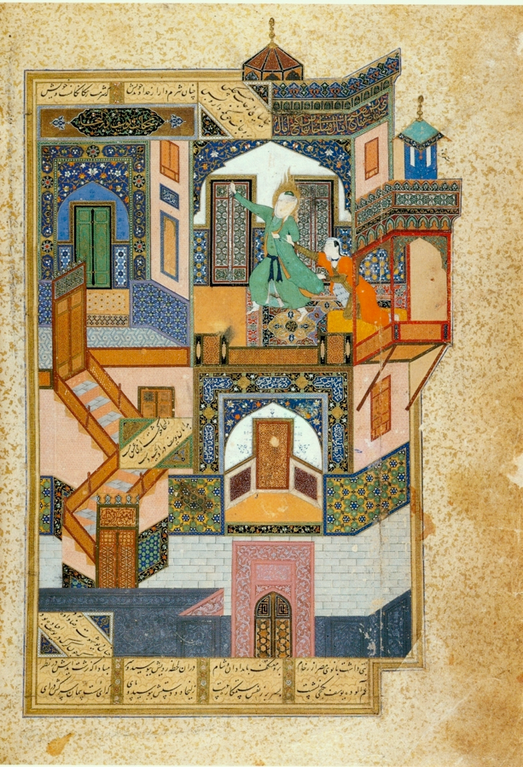
The Seduction of Yusuf, Persia 1488

Slide 67
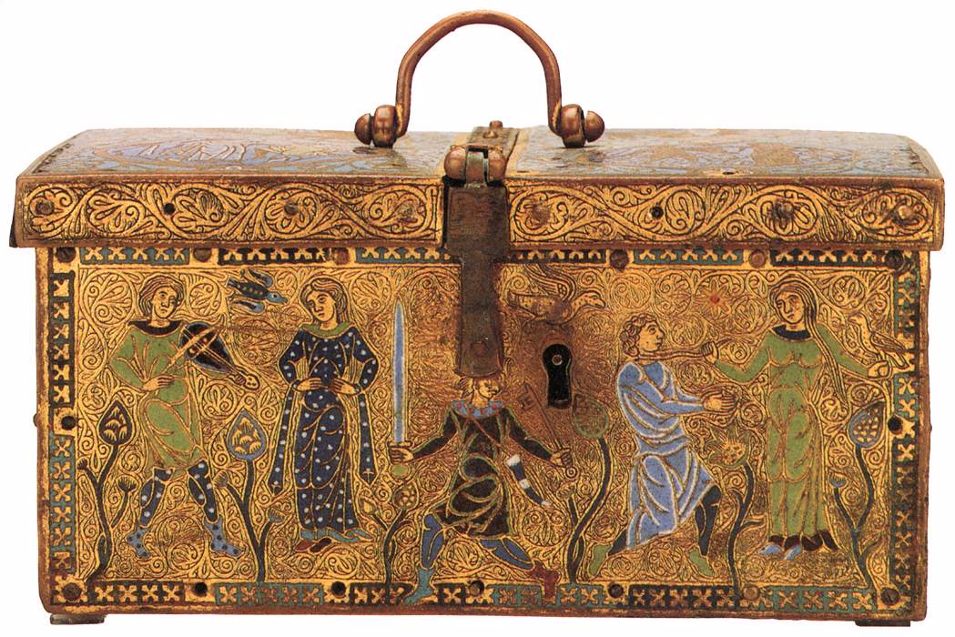
Medieval Casket with scenes of courtly love from Limoges,
France 1180
Video

Slide 68
An Allegory with Venus and Cupid, by Bronzino 1542
Video

Slide 69
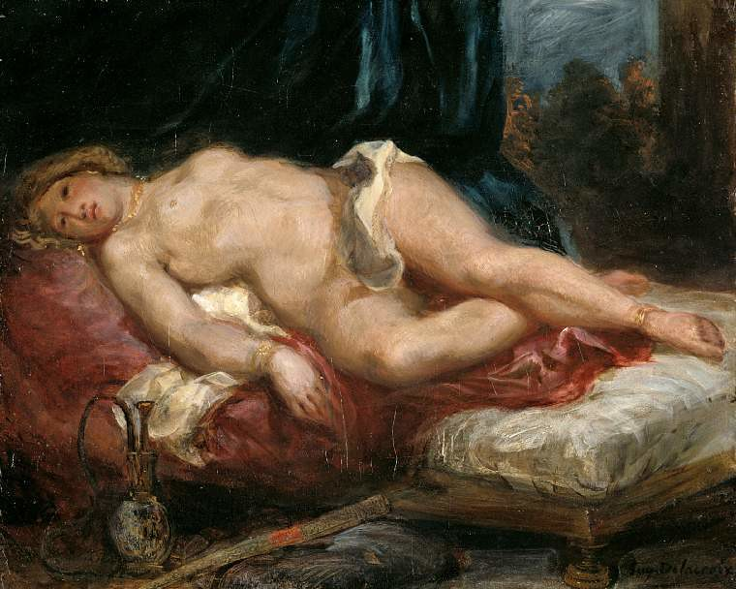
Odalisque by Eugene Delacroix 1850

Slide 70
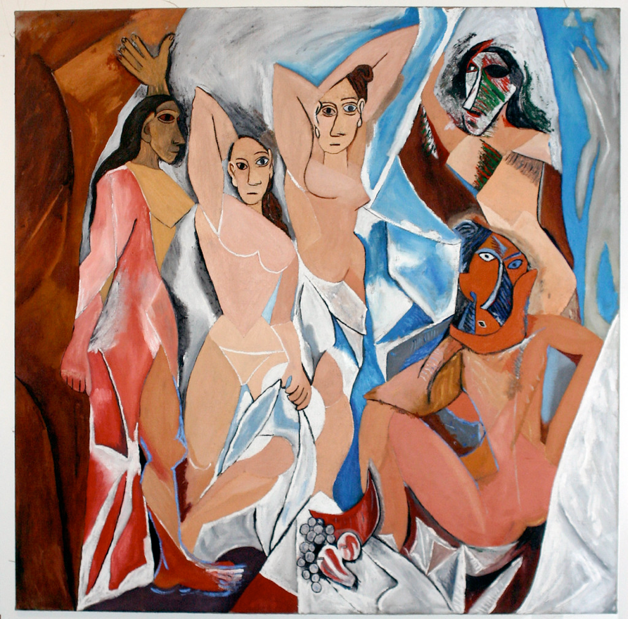
Demoiselles d’Avignon, Pablo Picasso, Spain 1907
Video

Slide 71
Demoiselles d’Avignon 1907
Video

Slide 72
The Kiss, Gustav Klimt, Vienna, Austria
Video

Slide 73
The Kiss, Auguste Rodin, 1889, Marble 5’ 11.5” Paris, France. As Auguste Rodin’s The Kiss demonstrates (see Fig. 23‑1), the evocation of touch is one of the most powerful ways to image desire, and, as the sculpture also demonstrates, the kiss is one of the most powerfully suggestive of all types of touch.
Video

Slide 74
The Kiss, Constantin Brancusi 1916, Limestone
Video

Slide 75
REVIEW
In Rodin’s sculpture, the kiss is one of the most powerfully suggestive of all types of touch.
The Hindu god, Shiva, is often shown in art as possessing the reproductive powers that led him to be represented as a lingam (phallus), often carved in stone on temple grounds or at shrines.

Slide 76
REVIEW
In Rodin’s sculpture, the kiss is one of the most powerfully suggestive of all types of touch.
The Hindu god, Shiva, is often shown in art as possessing the reproductive powers that led him to be represented as a lingam (phallus), often carved in stone on temple grounds or at shrines.

